Slide 1
Ant Colony Optimization of the Traveling Salesman Problem
Alexandre Clavel

Slide 2
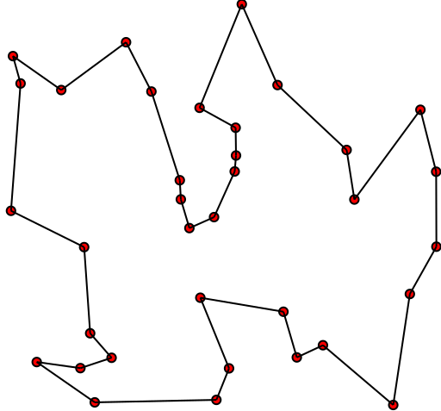
Problem
Given n points in space, find the shortest path going through each point exactly once, and returning to the initial point

Slide 3
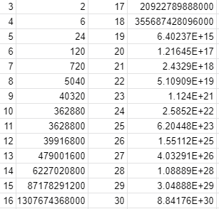
Trivial Solution
This problem can be brute forced by searching every permutation of paths between points.
However, this implementation has a time complexity of O((n-1)!)

Slide 4
Ant Colony Optimization
Create m ants, starting at random points
Each ant will find a valid path based on closest points, and a pheromone trail
Ants will then retrace their steps, depositing pheromones.
Shorter path = more pheromones
Pheromones will then evaporate over time
Repeat for i iterations
Eventually, the ants will find a path that is close to optimal, but has no guarantee to be the best
Runs in O(n*m*i)

Slide 5
Ant Colony Optimization Parameters
Number of ants: Number of ants to simulate every iteration
Pheromone intensity: Factor influencing how much pheromone is placed
Distance Power: Scaling factor making close points more desirable
Pheromone Power: Scaling factor making high pheromone paths more desirable
Dissipation: Proportion of laid down pheromones that evaporate every iteration

Slide 6
Implementation Specifics
Desirability = pow(distances, distance_power)
* pow(pheromones, pheromones_power)
Pheromone decay: Pheromones *= (1-dissipation)
Pheromone over path += pheromone intensity / distance of path

Slide 7
Potential issues
Large amount of parameters can cause issues
Parameters must be tuned for each individual problem
No guarantee of best solution
Algorithm can get ‘Stuck’ in close to good solution
Changing parameters requires a full restart

Slide 8
Demonstration

